Slide 1
WELCOME to P.A.C.E
Miss Berry
Room 206 & 207
2020-2021

Slide 2
MISSION
Miss Berry's class is a respectful classroom established to build a foundation for excellence through academic, behavioral, and social success.

Slide 3
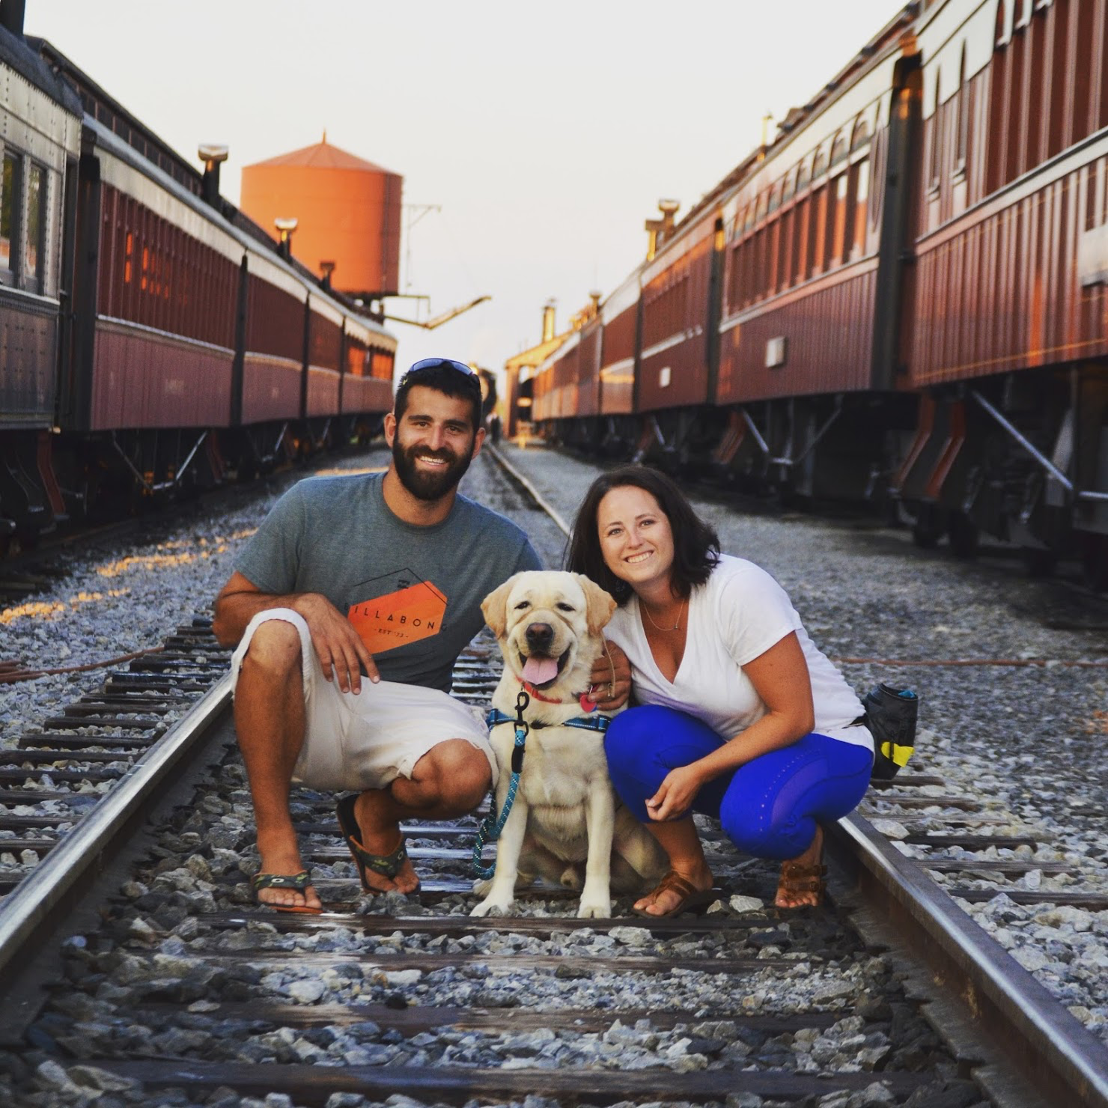
Miss Berry

Slide 4
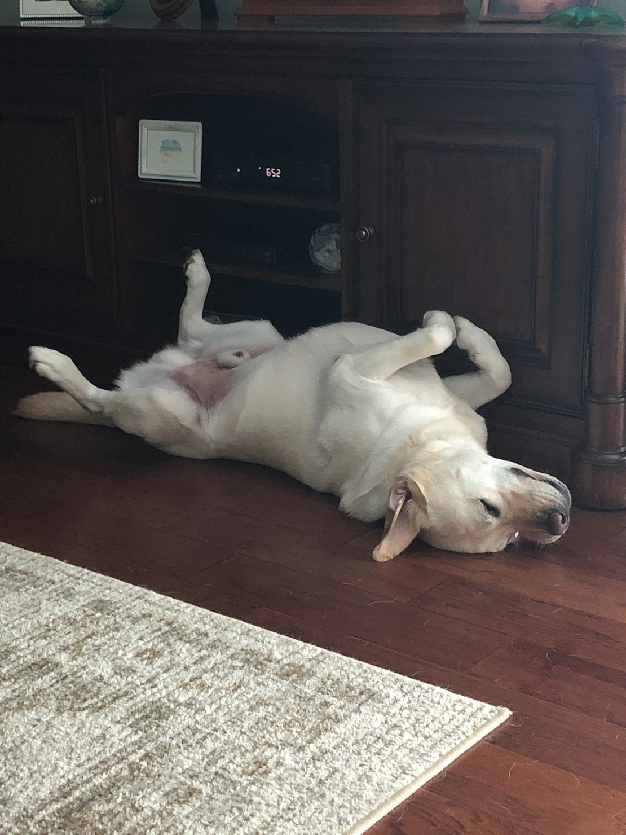
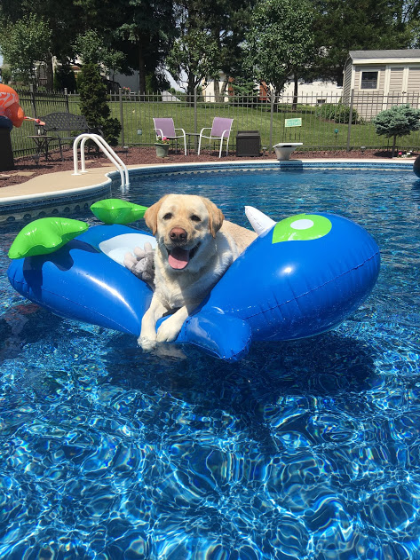
Murray

Slide 5
Our Staff
Mrs. Veres
Mrs. Strayer
We currently are still searching for an instructional aide to join our team!

Slide 6
SCHOOL WIDE RULES
Tardy to Class
Students are expected to be to their assigned location on time. Teachers will email the office when a student is tardy to class.
6thTardy=1 hour after school detention
7th Tardy=2 hour after school detention
8th and Subsequent Tardy= 2 hour after school detention and hallway restriction.

Slide 7
SCHOOL WIDE RULES
Cell Phones/Devices
If you have a device out, I will ask you to put it on my desk in a box and you can get it during break or designated times
Allowed before school, between classes, lunches, and after school
Technology sign will be displayed at all times

Slide 8
SCHOOL WIDE RULES
Dress Code
No hats/hoods
Under garments (boys underwear or boxers and girls bra straps) should be covered

Slide 9
SCHOOL WIDE RULES
Food and Beverages in the Building
Students may not bring open containers of food or beverages into the school in the morning
No food or drinks in the hallway
Water bottles (water only) may be used in the classroom

Slide 10
Homework Policy
Homework will be turned in the day following when it was assigned by every student with no exceptions.
If a student is given an assignment and they are absent on the following day or days, the assignment is due the day they return.
If a student is absent, they will receive assignments they missed on the day they return. Students will have the same number of days they were absent to make up the assignments.

Slide 11
Homework Policy
The student is to copy their homework assignments into their planner daily.
The student is to keep their homework in the Homework Folder.
The student is to complete the homework assigned each night following the expectations given by the teacher giving their very best effort.
The student must have the homework at their desk (not in backpack) on the day it is due.

Slide 12
Class Rules
Our goal is to prepare students as best as possible for the real world once they graduate for Northern High School.
Every classroom has rules, ours were created to mimic real life laws that students will need to be aware of.

Slide 13
Why do we have rules?
A policy is a plan that guides our actions.
To do things effectively, we have to adhere to some commonsense policies:
-Governments invoke laws to help maintain -peaceful communities.
-Companies have by-laws in order to facilitate productive work environments.
-Games have rules to create a baseline standard of play.
So, to be successful in learning, you need to follow some basic classroom rules!
-We call them our class policies.

Slide 14
Classroom Rules
Please refer to the bulletin board located in the back of the classroom!
We are here to learn! ☺

Slide 15
TOMORROW is always a new day ☺

Slide 16
When You Are Absent
You need to check in with us to see if you have any missed work due to your absence.
During class is NOT the time to work on missing assignments. This should be done after school or when there is extra time.
If you missed a test because of an excused absence, we will set up a time to make the test up.

Slide 17
Community Based Instruction
Marzoni's
Salvation Army
Administration Building at Northern
Paulus Orchard
New Hope Ministries
Polar Care Closet
Select Physical Therapy
High School Cafeteria
High School Athletic Center

Slide 18
Fundraising
October | Caramel Apples
November | Pumpkin Centerpieces
December | Dog Treats
January | Chocolate Covered Pretzels
February | T-Shirts
March | Peanut Butter Eggs
April | Northern Mugs

Slide 19
Electives
Every student picked an elective to be in for the 2020-2021 school year. Every student goes to an elective at least once a cycle!
Welding
Culinary Arts
Wildlife
Small Animal Pet Care
Drawing/Painting
Wood Tech/ Metal Tech
Floral Design

Slide 20
Any questions?
Lauren Berry: lberry@northernyork.org

Slide 21
Office of Vocational Rehabilitation
Caitlin Mento

Slide 22
Caitlin Mento M.S., CRC | VR Counselor
Office of Vocational Rehabilitation | York District Office
Pennsylvania Department of Labor & Industry
2550 Kingston Road, Suite 101 | York, PA 17402
Office Phone: 717.771.4407 ext 234 | Toll-Free: 800.762.6306 ext 234
Cell: 717.747.4835 | Fax: 717.771.4421
www.dli.state.pa.us

Slide 23
OVR’s Mission: To help Pennsylvanians with disabilities to secure and maintain competitive employment and independence

Slide 24
If a student seems like an appropriate referral to OVR and would benefit from services, you can contact the OVR York Office at 717-771-4407. They will be happy to help you in the process of accessing OVR services.

Slide 25
The student will fill out the application and then give it back to Ms. Betz who will forward it to me.
OVR Services may include some of the following:
Vocational Evaluation at HGAC or Goodwill
Project SEARCH & Project PAS
Neuro Psych Evaluation
Community Based Work Assessment
Vocational Counseling and Guidance
Assistive Technology Evaluation
Functional Capacity Evaluation
Driving Evaluation (assess ability to drive & what accommodations would be necessary)
Referral to other community resources
Job search assistance- interview practice; resume; jobs-for-all On the Job Contract (OJT)

Slide 26
The student will fill out the application and then give it back to Ms. Betz who will forward it to me.

